Slide 1
The Memento Pattern (Behavioral)

Slide 2
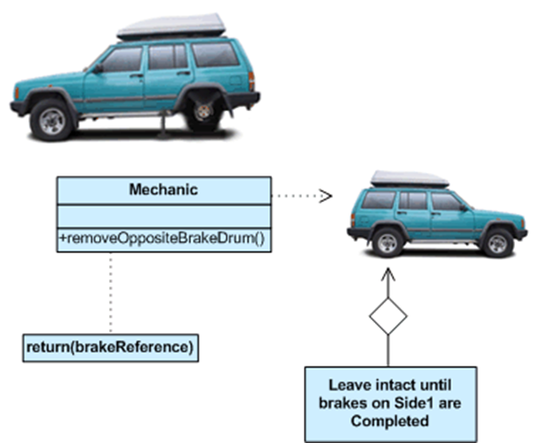
Memento in the Real World

Slide 3
Memento: Basic Idea
Sometimes it is necessary to record the internal state of an object; e.g., when implementing checkpoints and undo mechanisms. You must save the state information somewhere so that you can restore objects to their previous state.
But objects normally encapsulate some or all of their state, making it inaccessible to other objects and impossible to save externally.
A memento is an object that stores a snapshot of the internal state of another object, the memento’s originator.

Slide 4
Memento: Basic Idea (continued)
The originator initializes the memento with information that characterizes its current state.
Only the originator can store and retrieve information from the memento – the memento is “opaque” to other objects.

Slide 5
Memento Pattern
Intent: Without violating encapsulation, capture and externalize an object’s internal state so that the object can be restored to this state later.
Also Known As: Token

Slide 6
Memento Pattern Applicability
Use the Memento pattern when
a snapshot of some portion of an object’s state must be saved so that it can be restored to that state later,
and
a direct interface to obtaining the state would expose implementation details, and therefore would break the object’s encapsulation.

Slide 7
Memento Pattern Structure
Originator
state
setMemento(Memento m)
createMemento()
Memento
state
getState()
setState()
memento
Caretaker
return new Memento(state)
state = m.getState()

Slide 8
Memento Pattern Participants
Memento
stores internal state of the Originator object.
protects against access by objects other than the originator.
narrow interface for Caretaker (can only pass the memento to other objects
wide interface for Originator (lets the originator access all data necessary to restore itself to its previous state)
Originator
creates a memento containing a snapshot of its current internal state.
uses the memento to restore its state.

Slide 9
Memento Pattern Participants (continued)
Caretaker
is responsible for the memento’s safekeeping.
never operates on or examines the contents of a memento.

Slide 10
Memento Pattern Collaborations
A caretaker requests a memento from an originator, holds it for a time, and passes it back to the originator
: Caretaker
: Originator
m : Memento
createMemento()
«create»
setState()
setMemento(m)
getState()

Slide 11
Memento Pattern Consequences
Preserves encapsulation boundaries. Memento avoids exposing information that only an originator should manage but that must be stored outside the originator.
Simplifies Originator. Moves the storage management burden from the Originator to the clients. Having clients manage the state they ask for simplifies Originator.
Can be expensive to use. Memento can incur considerable overhead if the originator must copy large amounts of information or if clients create/return mementos to the originator frequently.
Can have hidden costs. A caretaker can incur large storage costs when it stores mementos.

Slide 12
Memento Pattern Implementation
Language support. Mementos have two interfaces, a wide one for originators and a narrow one for other objects. C++ supports this requirement by letting you make Originator a friend of Memento and making Memento’s wide interface private. Only the narrow interface should be declared public.
Storing incremental changes. The memento can save just the incremental change to the originator’s internal state rather than the full state of every originator object.

Slide 13
Example
http://sourcemaking.com/design_patterns/memento/java/1

Slide 14
Related Patterns
Commands can use mementos to maintain state for undoable operations.
Mementos can be used to represent the current state of an iteration.

Slide 15
References
Memento pattern (Wikipedia)
http://en.wikipedia.org/wiki/Memento_pattern
Memento Pattern (Object-Oriented Design)
http://www.oodesign.com/memento-pattern.html
Memento Design Pattern (SourceMaking)
http://sourcemaking.com/design_patterns/memento
Memento (dofactory)
http://www.dofactory.com/Patterns/PatternMemento.aspx

